Slide 1



palmpay sales
View in Power BI
Last data refresh:
26/10/2025 13:35:33 UTC
Downloaded at:
26/10/2025 13:37:19 UTC

Slide 2
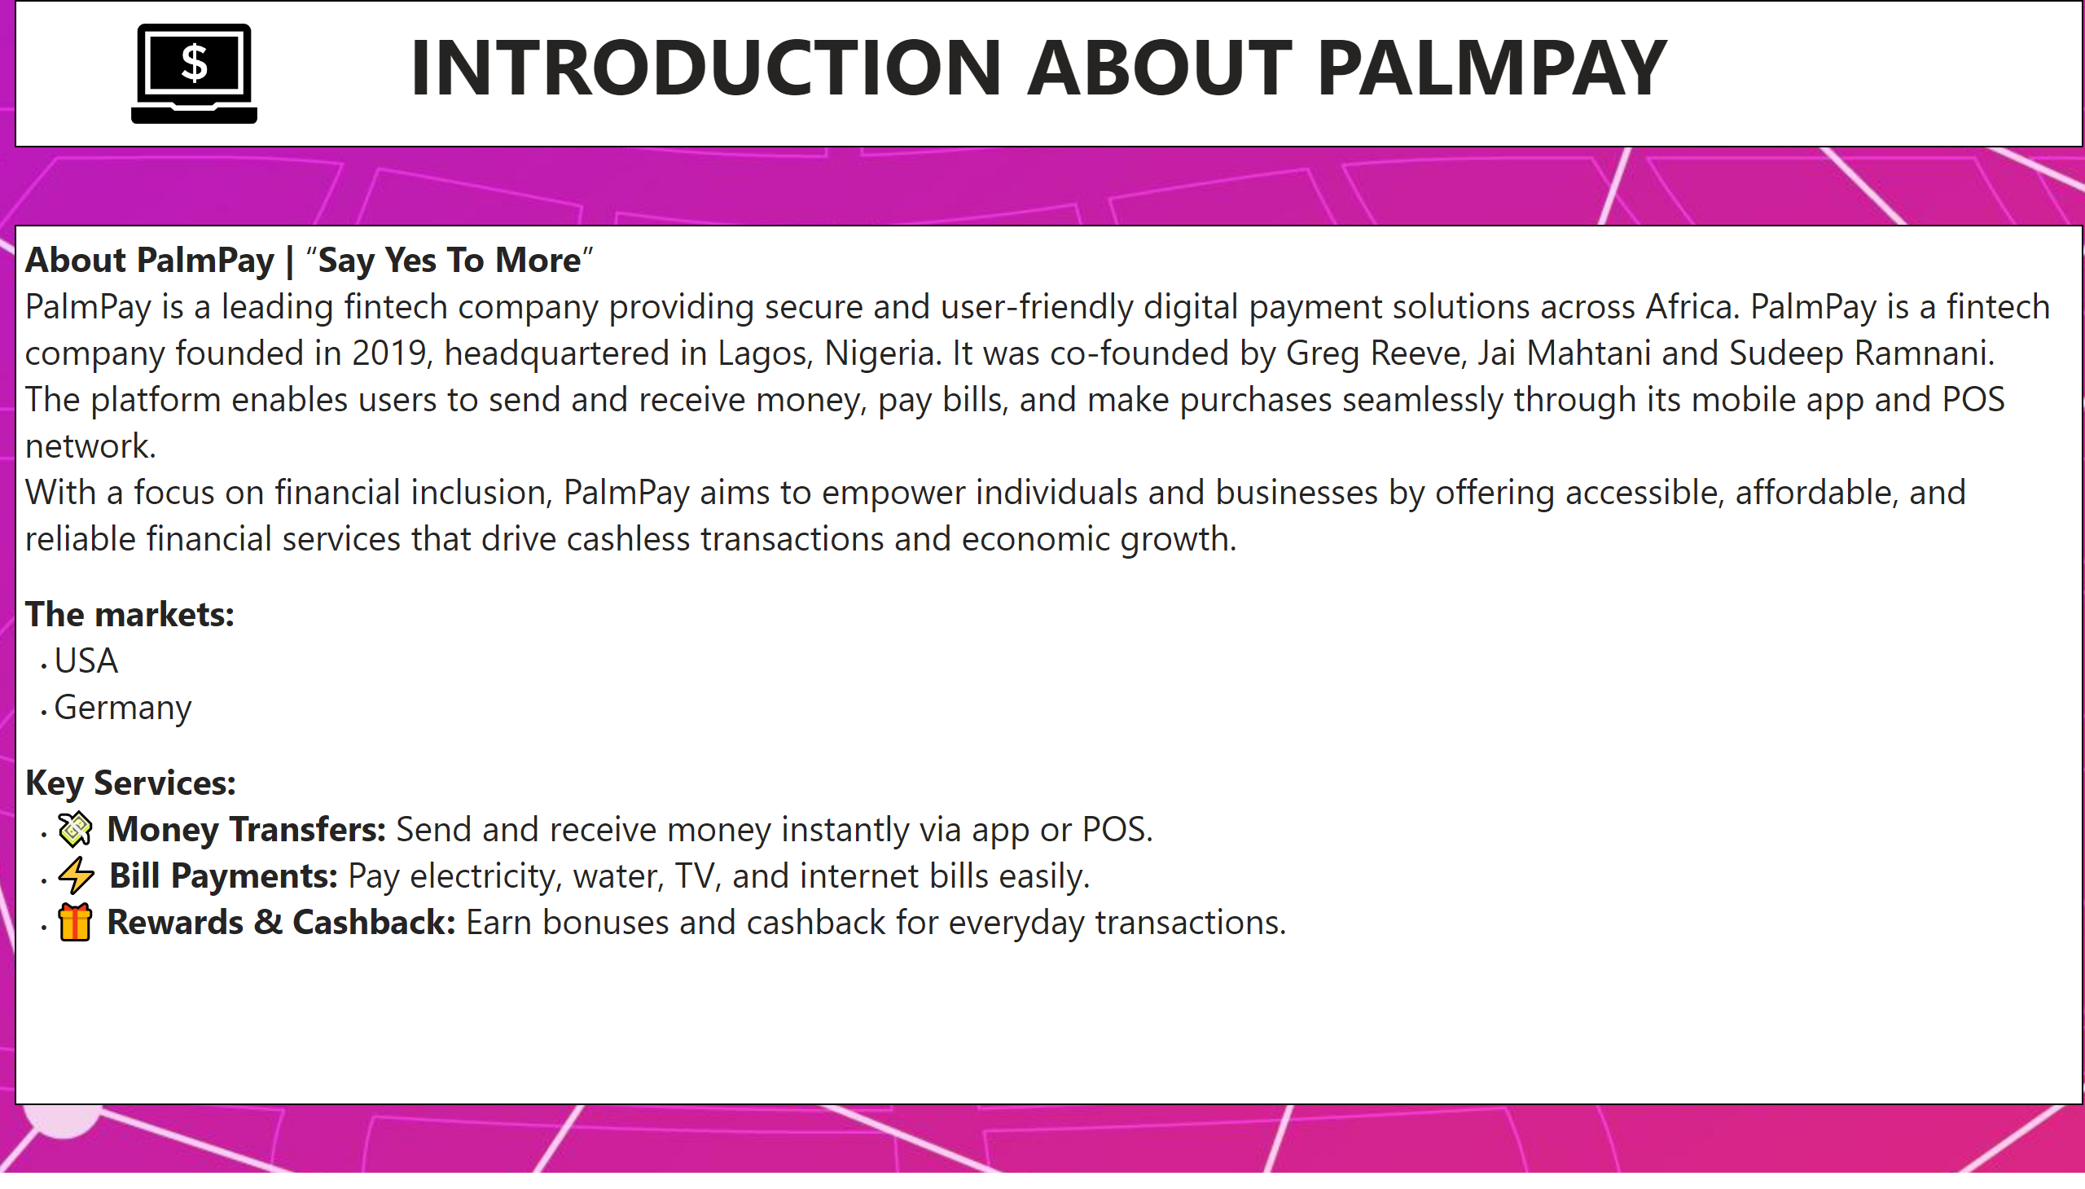
Introduction
Notes:
textbox
No alt text provided
image
No alt text provided
textbox
No alt text provided

Slide 3
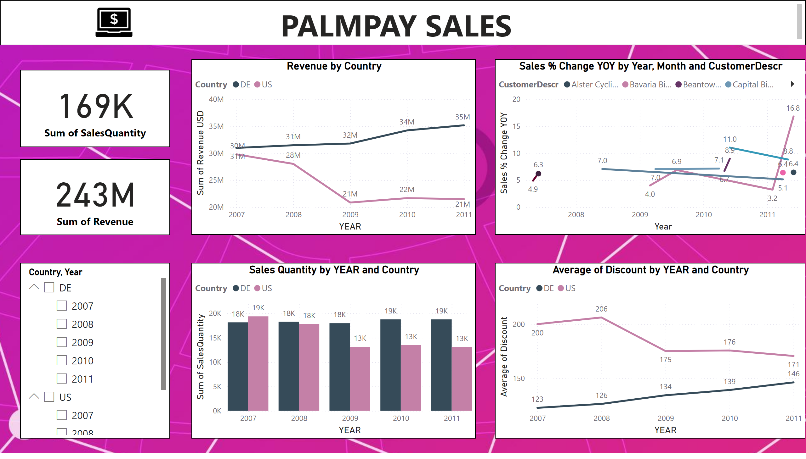
Section A
Notes:
Revenue by Country
No alt text provided
Sales Quantity by YEAR and Country
No alt text provided
lineChart
No alt text provided
lineChart
No alt text provided
textbox
No alt text provided
slicer
No alt text provided
card
No alt text provided
card
No alt text provided
image
No alt text provided

Slide 4
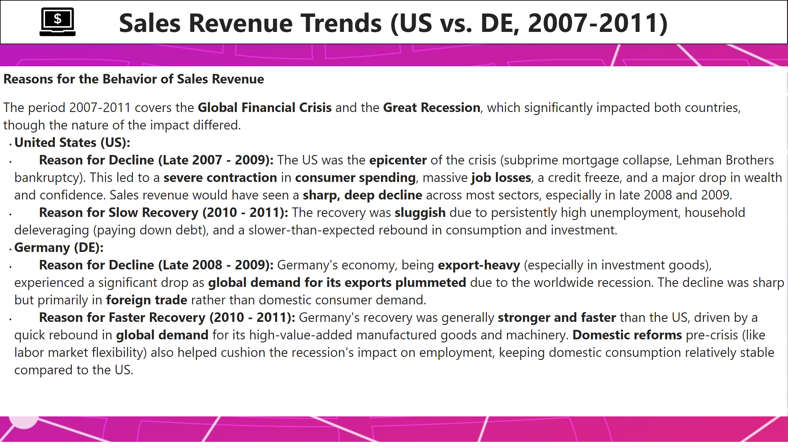
Summary note Q2
Notes:
textbox
No alt text provided
textbox
No alt text provided
image
No alt text provided

Slide 5
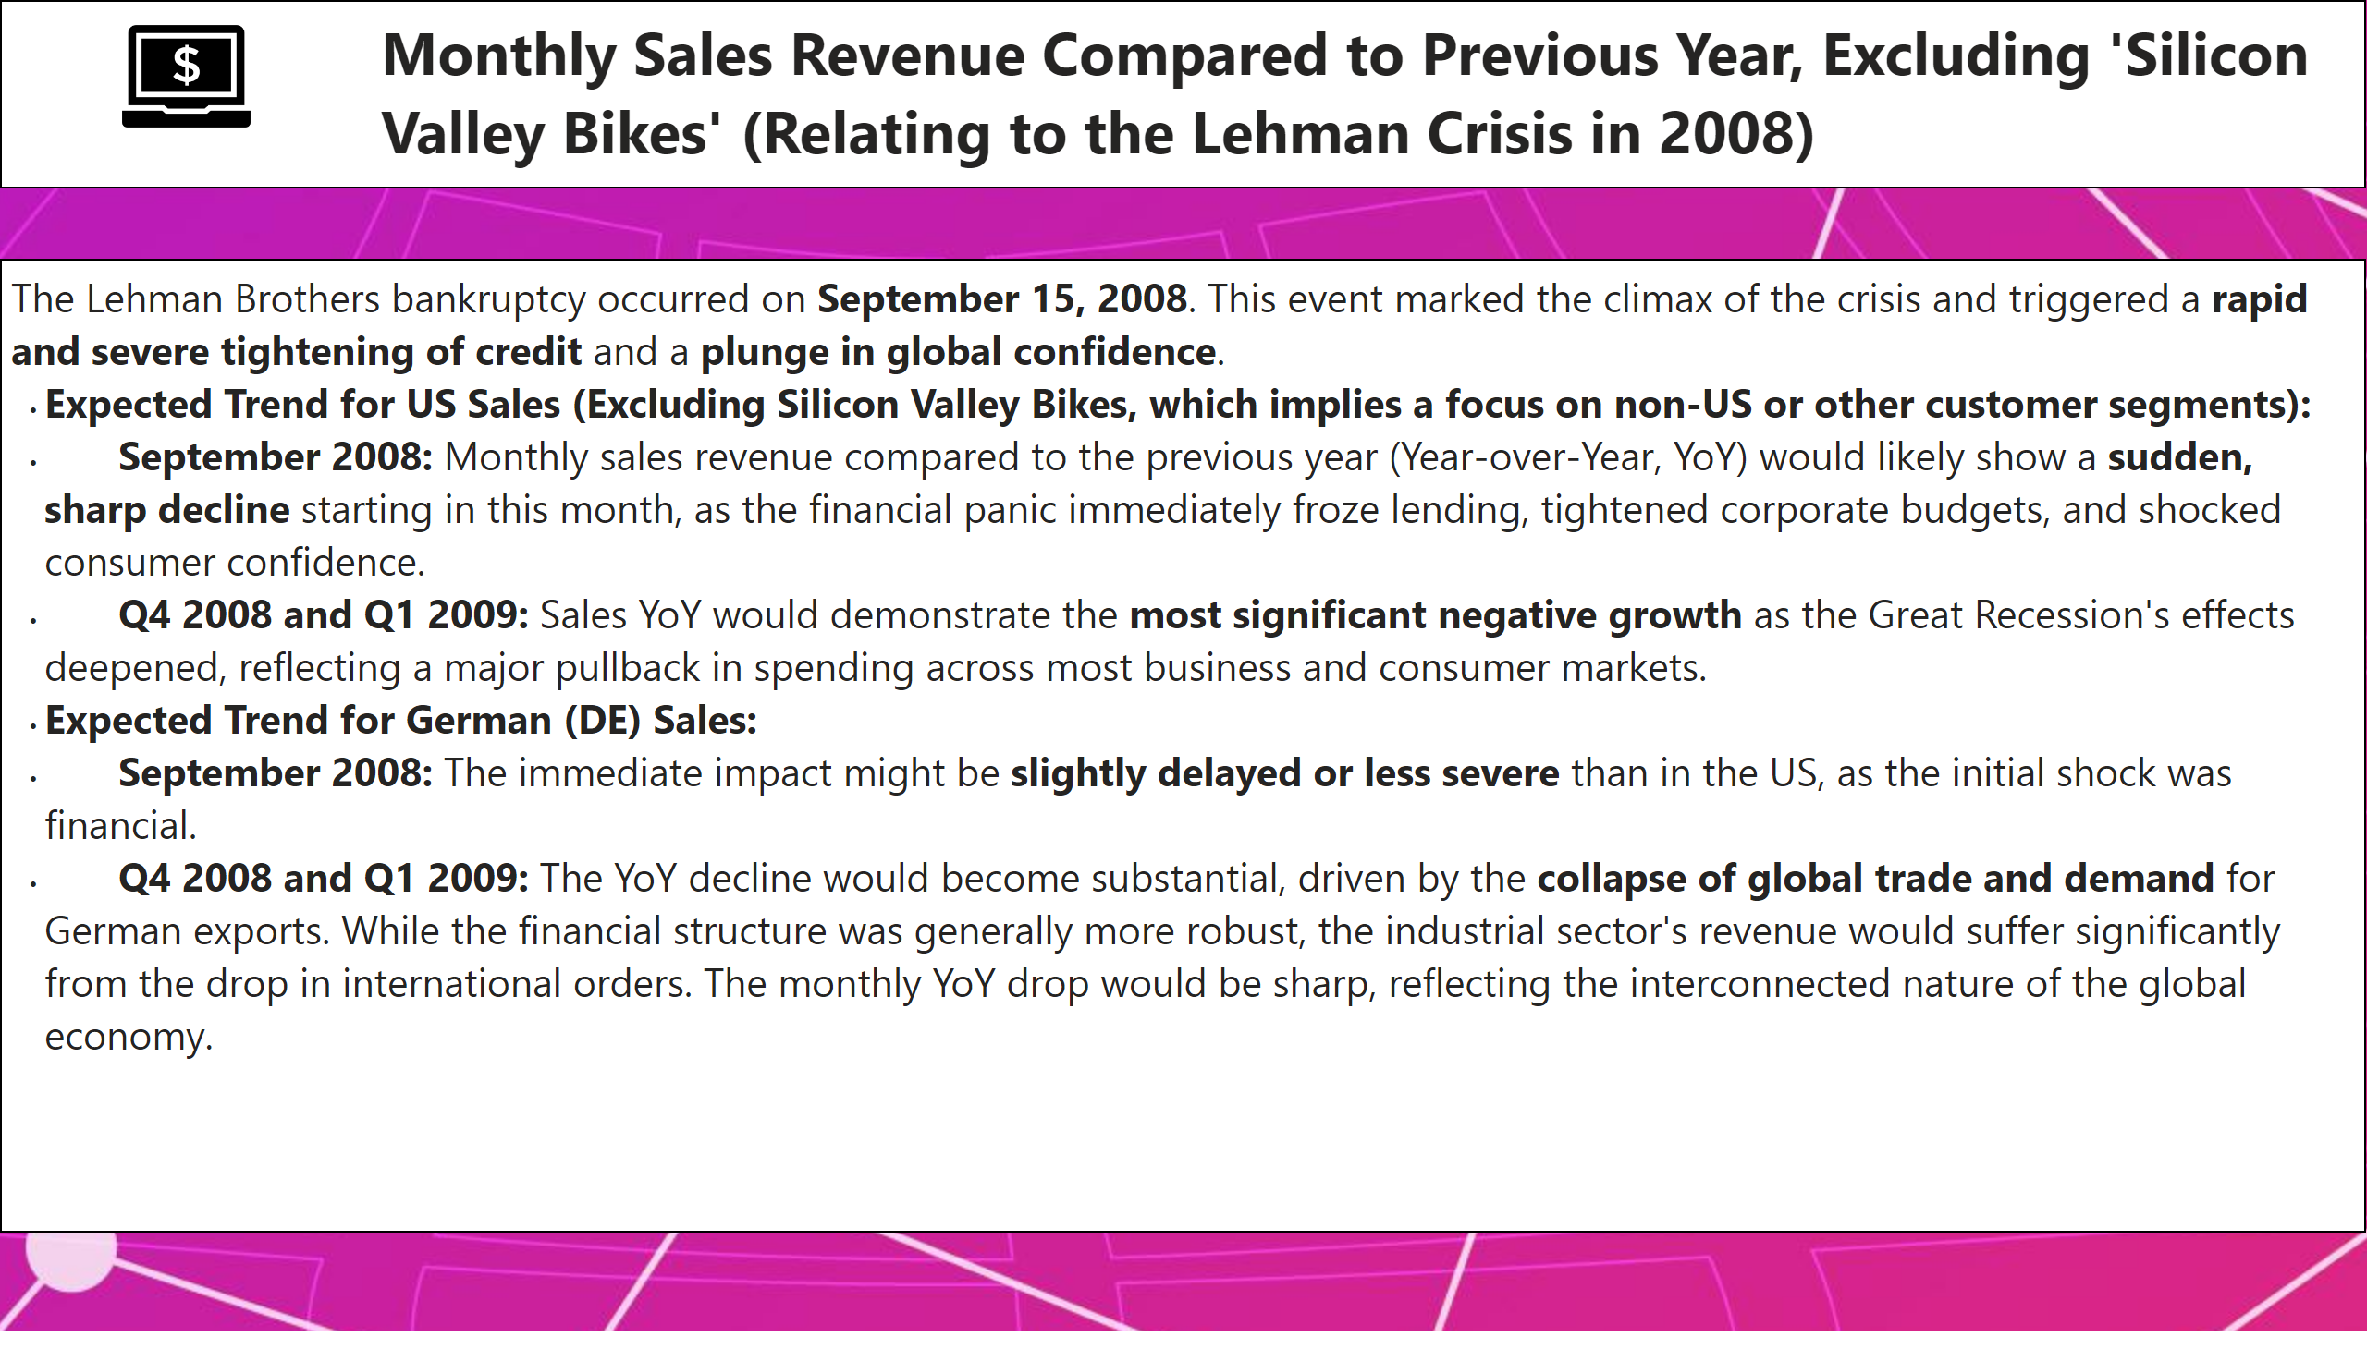
Summary note Q3
Notes:
textbox
No alt text provided
textbox
No alt text provided
image
No alt text provided

Slide 6
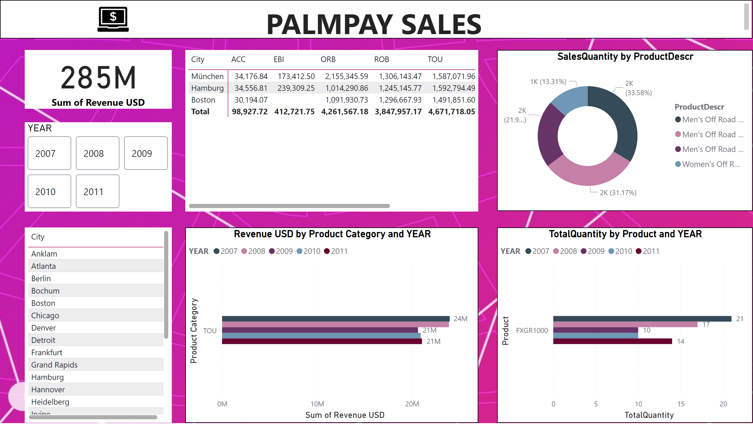
Section B
Notes:
clusteredBarChart
No alt text provided
Revenue USD by Product Category and YEAR
No alt text provided
SalesQuantity by ProductDescr
No alt text provided
textbox
No alt text provided
pivotTable
No alt text provided
card
No alt text provided
advancedSlicerVisual
No alt text provided
tableEx
No alt text provided
image
No alt text provided

Slide 7
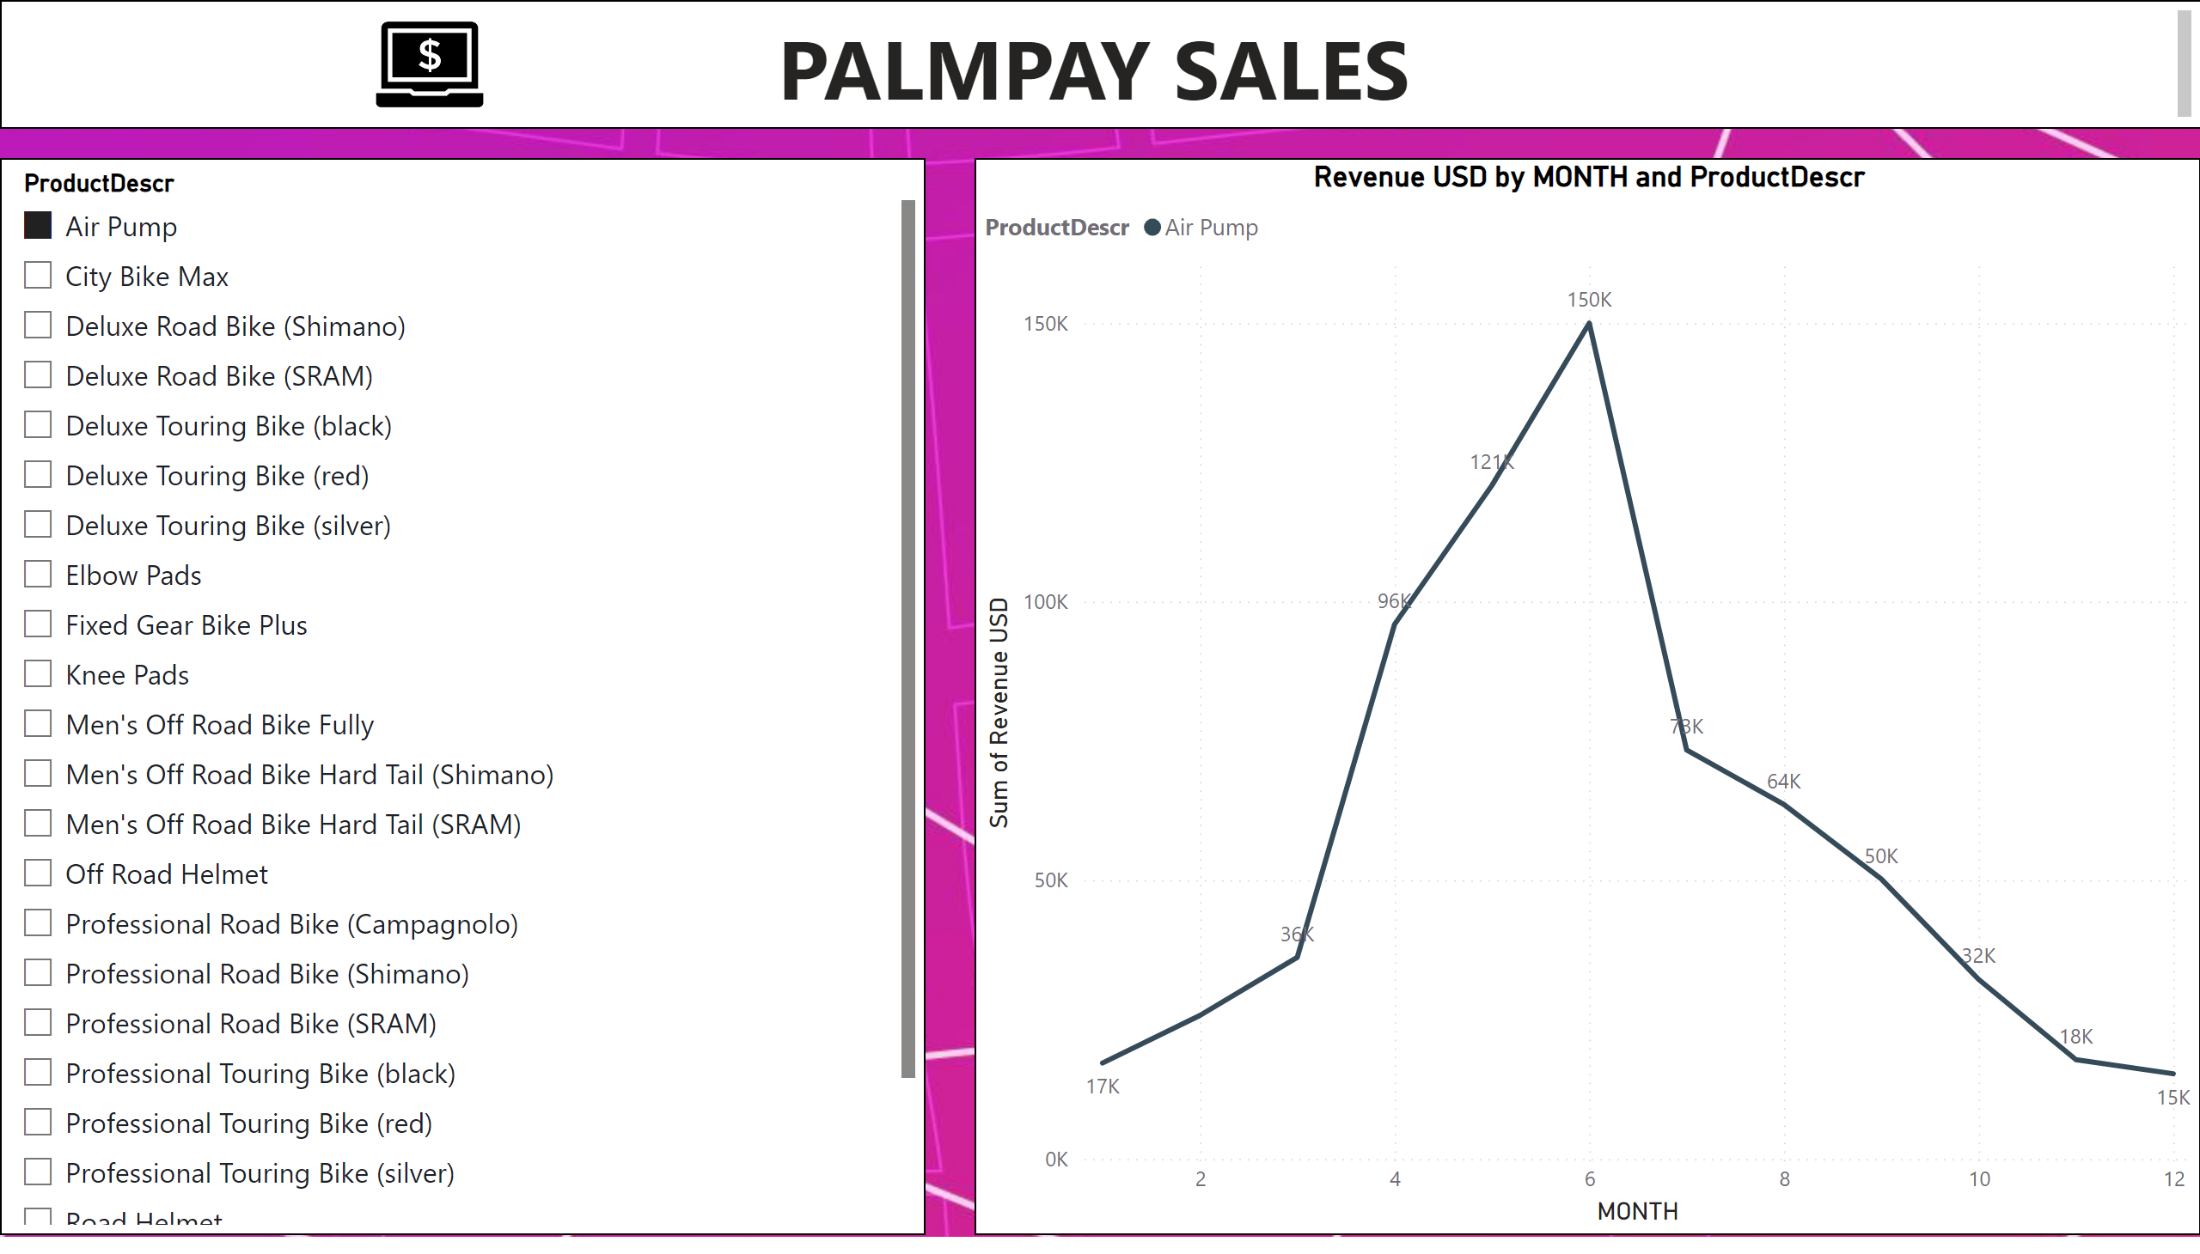
Section B Q4
Notes:
Revenue USD by MONTH and ProductDescr
No alt text provided
actionButton
No alt text provided
textbox
No alt text provided
slicer
No alt text provided
image
No alt text provided

Slide 8
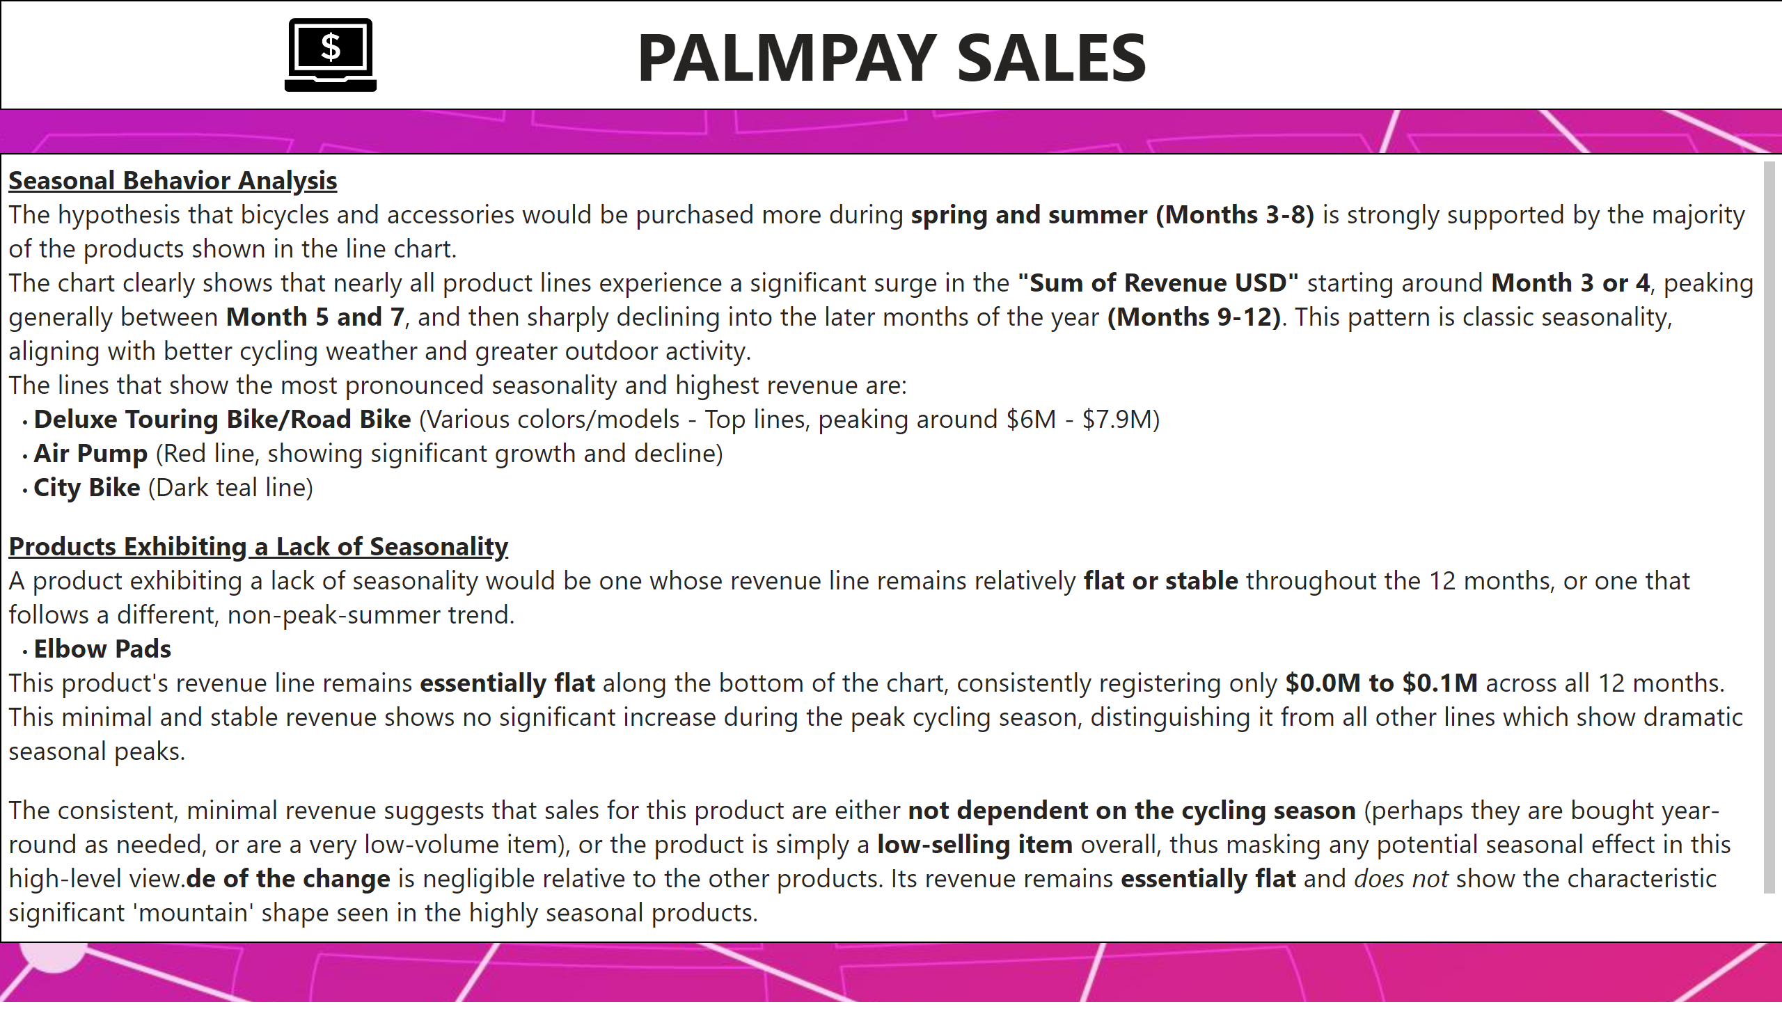
Summary note Q4
Notes:
textbox
No alt text provided
textbox
No alt text provided
textbox
No alt text provided
image
No alt text provided

Slide 9
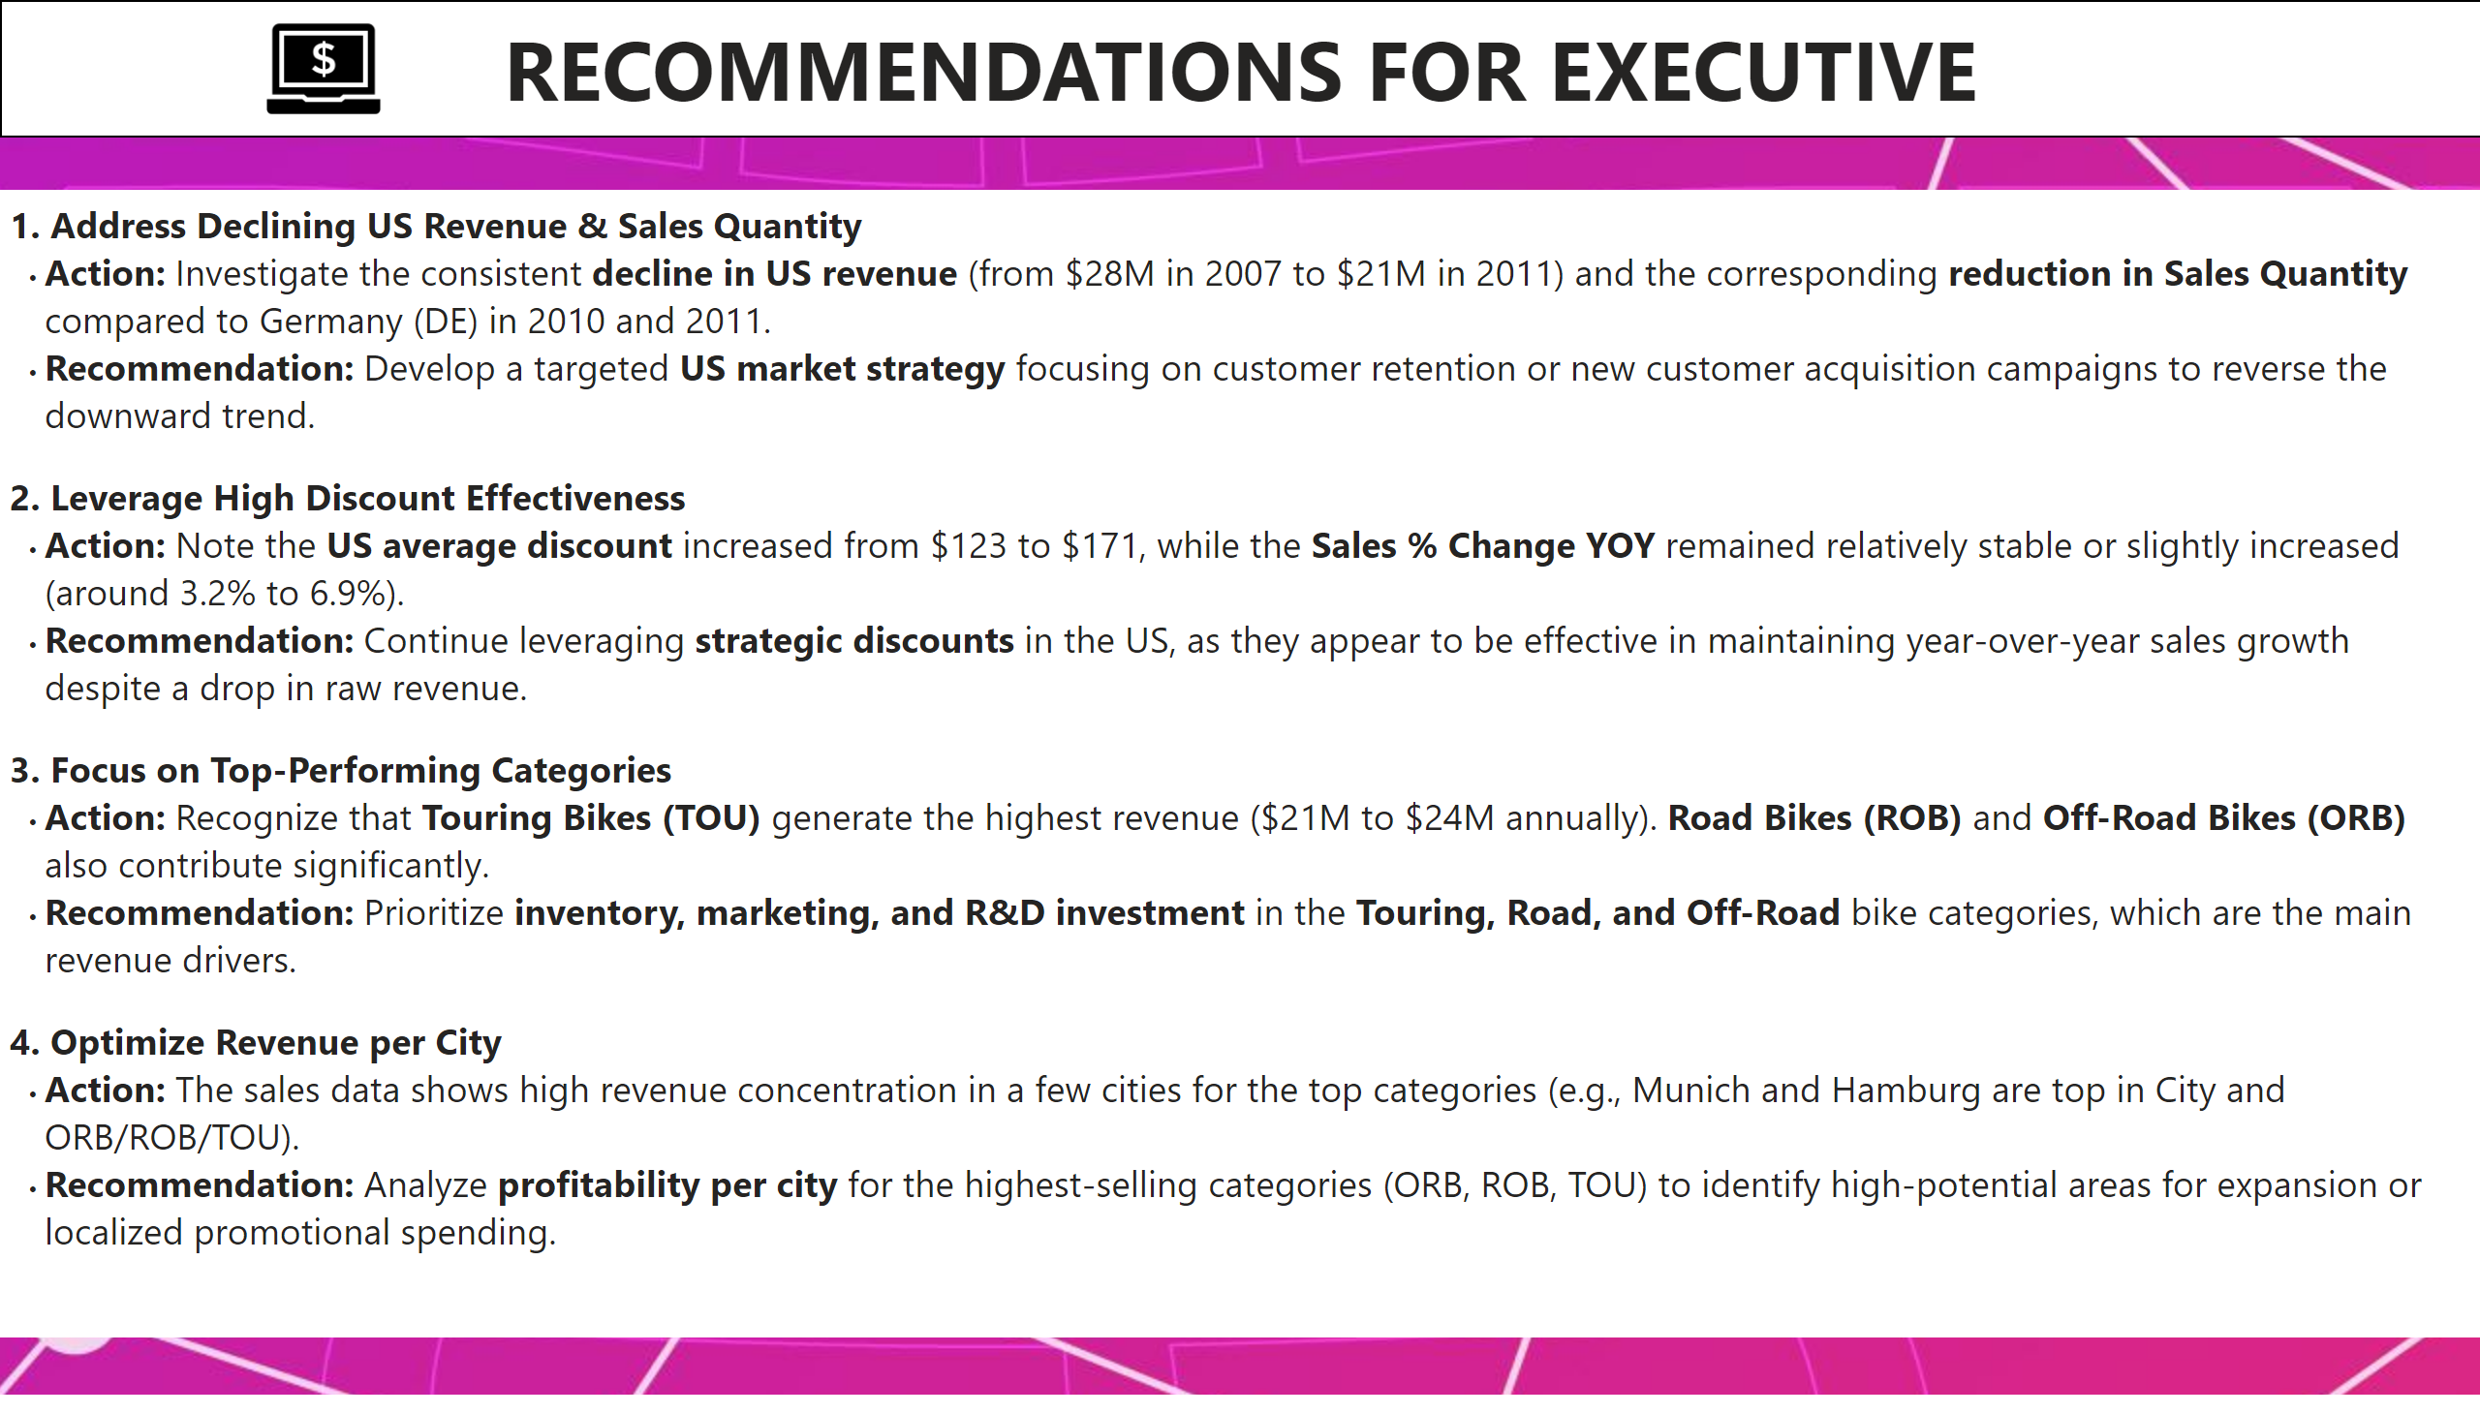
Recommendations
Notes:
textbox
No alt text provided
textbox
No alt text provided
image
No alt text provided

